Slide 1

City Power Consumption Analysis
This project analyzes city power consumption data to predict usage in Zone A. We explored the dataset, preprocessed it, and evaluated multiple machine learning models to find the best predictor.

Slide 2


Data Overview
1
Dataset Size
52,583 rows and 9 columns of power consumption data.
2
Key Features
Temperature, humidity, wind speed, diffuse flows, and air quality index.
3
Target Variable
Power consumption in Zone A.

Slide 3
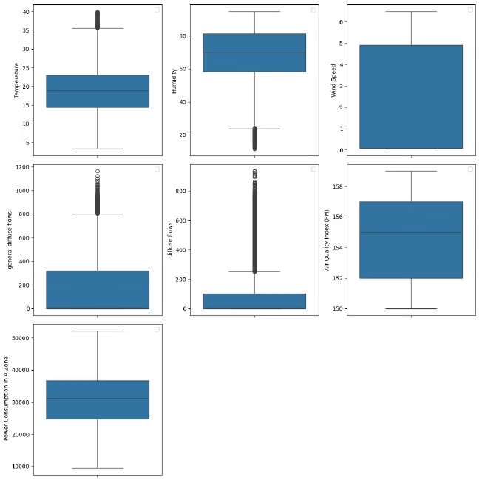
Data Preprocessing
1
Handling Missing Values
Used median imputation for numerical variables and most frequent for categorical.
2
Outlier Treatment
Applied outlier clipping to reduce impact of extreme values.
3
Feature Scaling
Standardized numerical features to ensure consistent scale across variables.

Slide 4
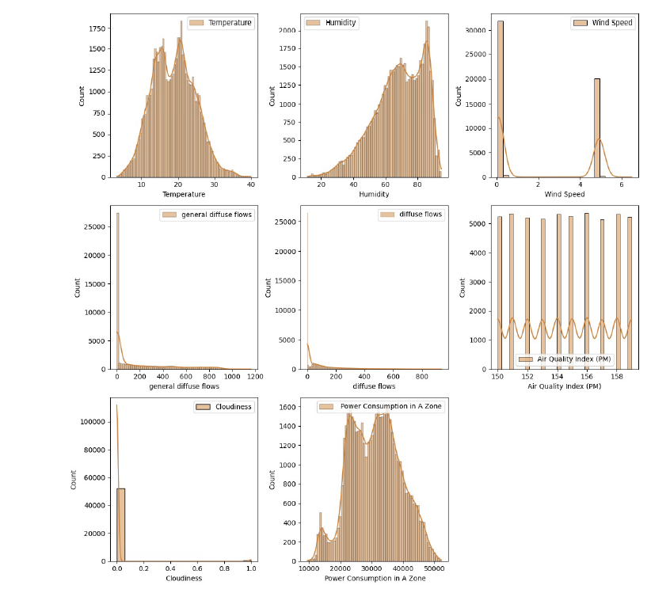
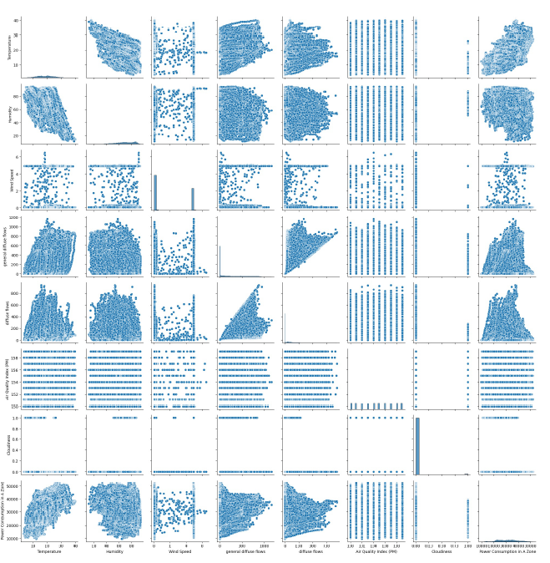
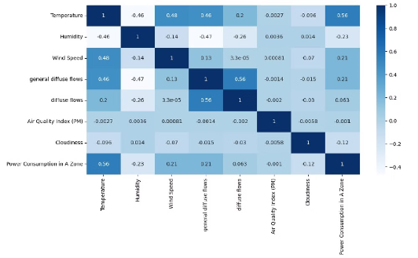
Exploratory Data Analysis
Correlation Analysis
Distribution Plots
Scatter Plots
Heatmap revealed relationships between variables, guiding feature selection.
Histograms showed data distributions, helping identify potential issues.
Pairwise scatter plots highlighted relationships between features and target variable.

Slide 5
Model Selection
Linear Models
Tree-based Models
Advanced Models
Linear Regression and SGD Regressor for baseline performance.
Decision Tree and Random Forest for capturing non-linear relationships.
Support Vector Regression and XGBoost for potentially higher accuracy.

Slide 6
Model Training and Evaluation
Data Splitting
Performance Metrics
80% training, 20% testing split for model evaluation.
Evaluated models using R2 score, MSE, MAE, and RMSE.
1
2
3
Hyperparameter Tuning
Used GridSearchCV to optimize model parameters.

Slide 7
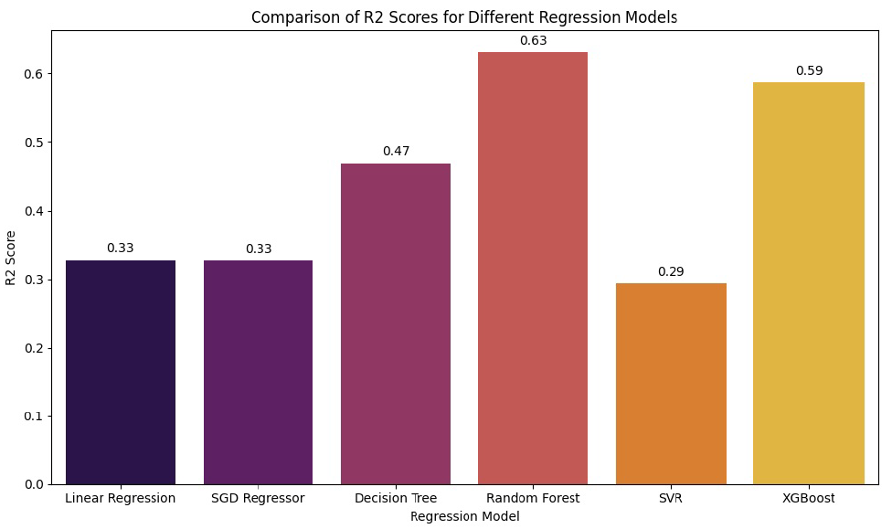
Model Performance Comparison
Best Performer
Runner-up
Baseline
Random Forest Regressor achieved highest R2 score of 0.63.
XGBoost Regressor came second with R2 score of 0.59.
Linear Regression and SGD performed similarly with R2 around 0.33.

Slide 8
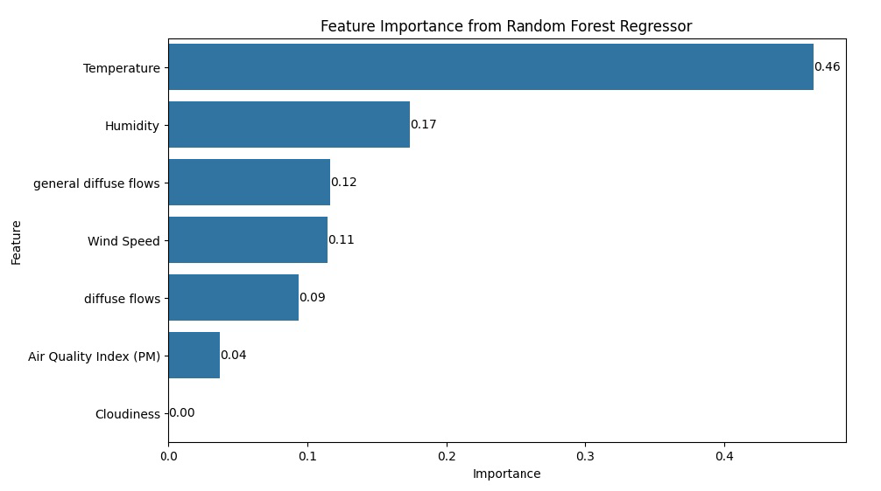



Feature Importance
Temperature
Most important feature with 46.37% importance.
Humidity
Second most important at 17.37%.
Diffuse Flows
General and specific diffuse flows combined contribute 21.08%.

Slide 9

Key Findings
1
Best Model
Random Forest Regressor outperformed other models in predicting power consumption.
2
Important Factors
Temperature and humidity significantly influence power consumption in Zone A.
3
Model Accuracy
Achieved 63% accuracy in predicting power consumption variations.

Slide 10
THANK YOU

